Slide 1
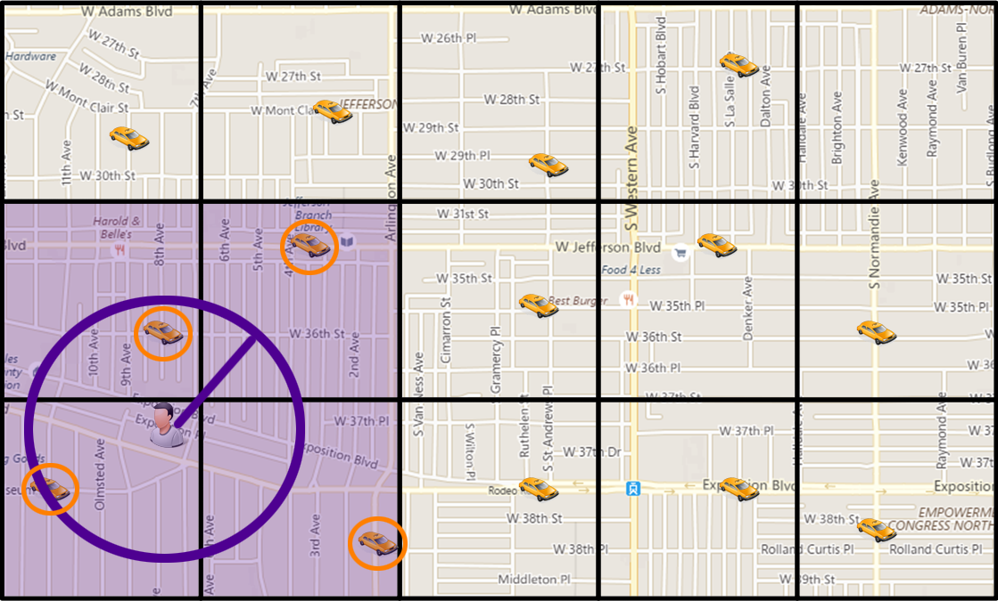
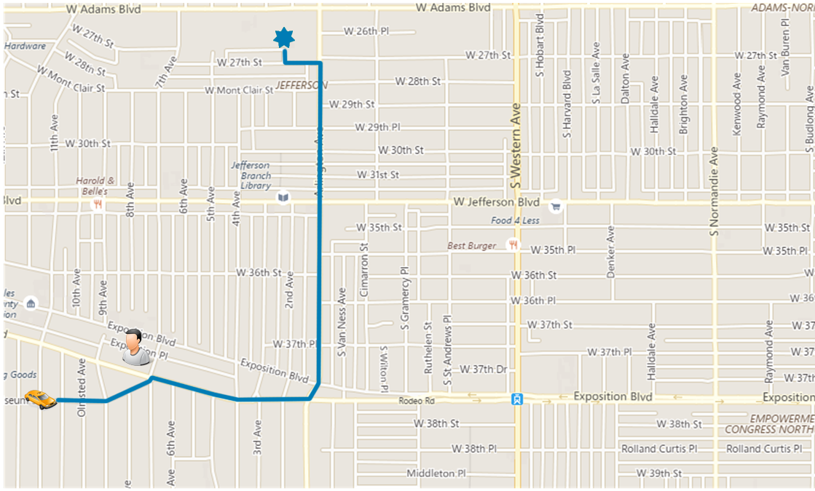
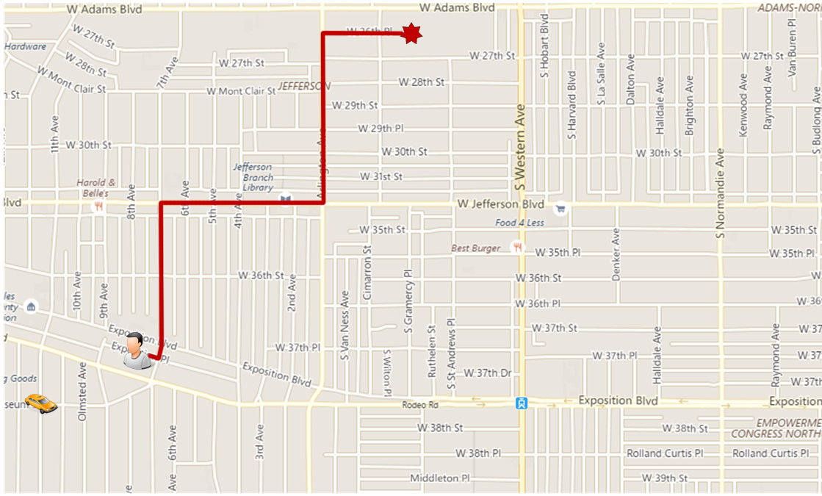
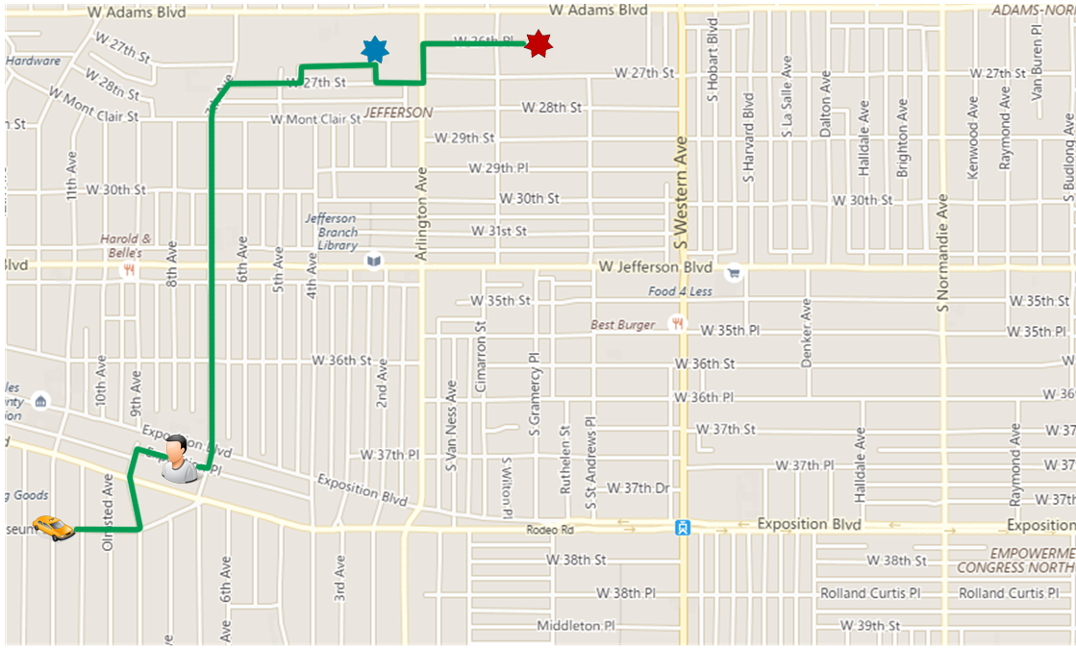



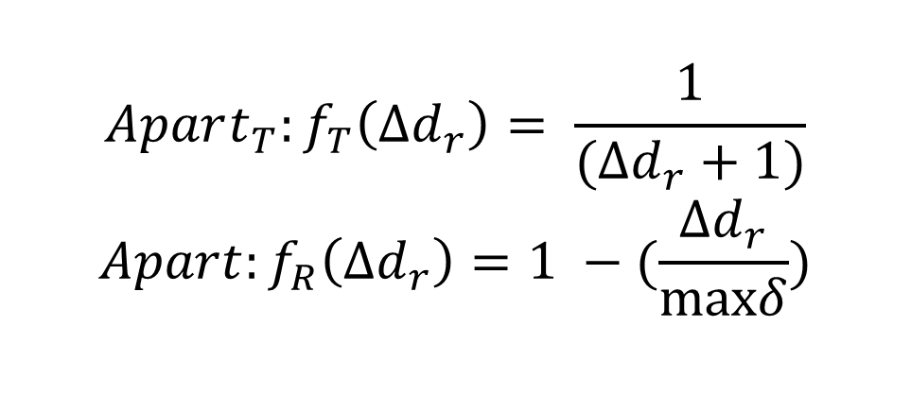
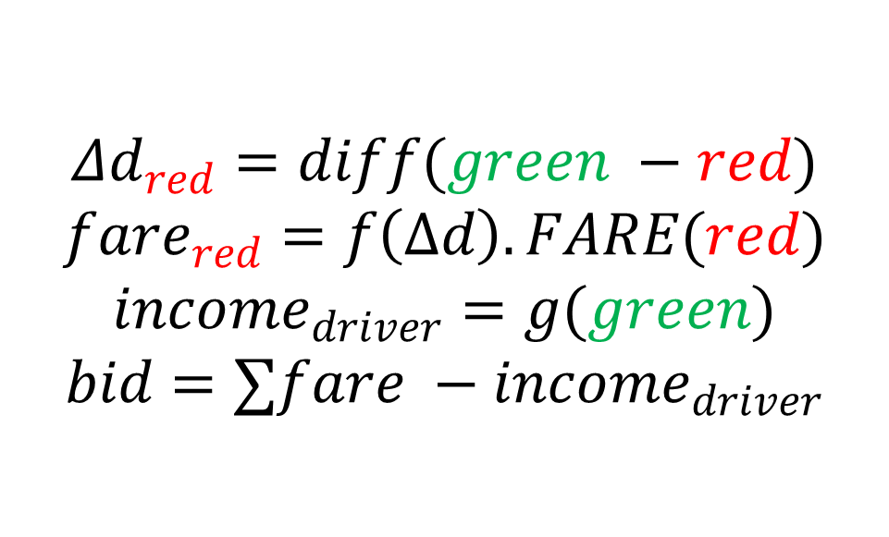

Price-aware Real-time Ride-sharing at Scale-
An Auction-based Approach
Mohammad Asghari, Dingxiong Deng, Cyrus Shahabi, Ugur Demiryurek, Yaguang Li
Integrated Media Systems Center University of Southern California
Introduction
Traditional Ride-sharing focused on only matching people with similar routes.
Increasing popularity of commercial Ride-sharing requires focus on pricing.
Simple Scenario
Server identifies potential drivers
Each potential driver computes its bid locally
Pricing Model
In a Fair system:
+ The rider should receive a discount proportional to the detour
incurred to his trip.
+ The driver’s compensation should increase proportional to
the distance of his trip.
Driver’s Original Route | Requester’s Shortest Route
$$Δd_{red}=diff(green −red)$$ $$fare_{red}=f\left(Δd\right).FARE(red)$$ $$income_{driver}=g(green)$$ $$bid=∑fare −income_{driver}$$
Final Route
Evaluation
Dataset: NYC Taxi Trips in May 2013 (40K drivers & 500K trips per day)
Algorithms: Apart (our framework), Tree[1] (optimize shortest travelled
distance) & NN (always select nearest neighbor)
Pricing: $F\left(d\right)=2×d$, $f_{r}\left(Δd\right)=1−\left(0.25×Δd_{r}^{2}\right)$ and $g_{v}\left(d\right)=1.5×d$
Different Pricing Model [2]: $g_{v}\left(d_{1},d_{2}\right)=c.d_{1}+\left(1+α\right).c.d_{2}$
Effect of profiles:
[1] Y. Huang et. al., Large scale real-time ridesharing with service guarantee on road networks, VLDB’17
[2] S. Ma et. al. T-share: A large-scale dynamic taxi ridesharing service, ICDE’13
Framework
Service Rate | Revenue | Response Time
Users that Saved Money | Users that Lost Money
$$Apart_{T}:f_{T}\left(Δd_{r}\right)= \frac{1}{(Δd_{r}+1)}$$ $$Apart:f_{R}\left(Δd_{r}\right)=1 −(\frac{Δd_{r}}{maxδ})$$
Effect of Profiles
IMSC Retreat 2017
Notes:
*

